Slide 1

Estonia’s reflection on Commission’s assessment of Estonia’s NECP Merilyn Möls Policy lead of Climate strategy Climate Department 02 June 2026

Slide 2
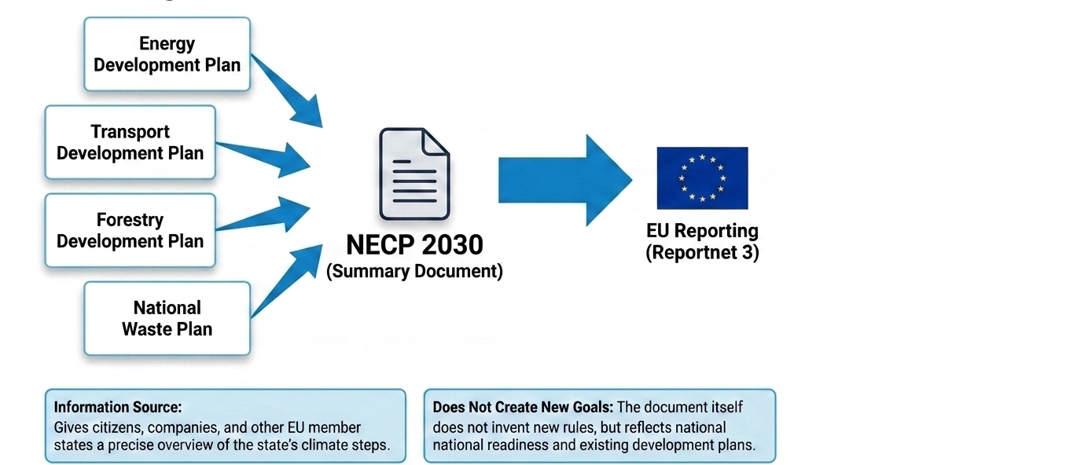
NECP acts as a mirror, synthesizing existing national measures and energy objectives

Slide 3
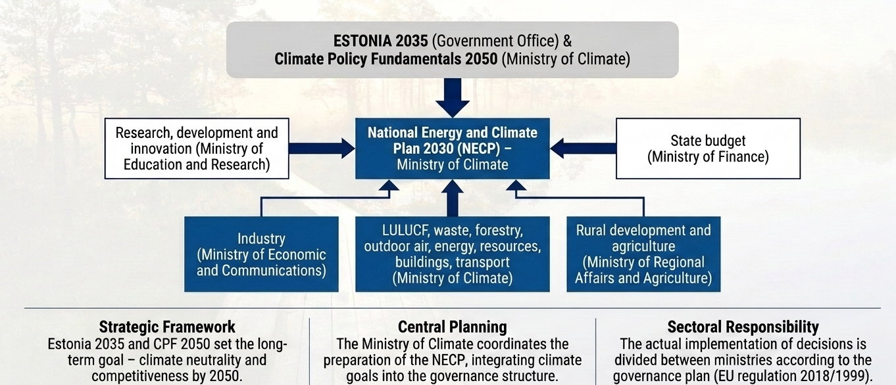
Estonia’s National Energy and Climate Plan summarises the country’s current climate and energy policy objectives and measures

Slide 4
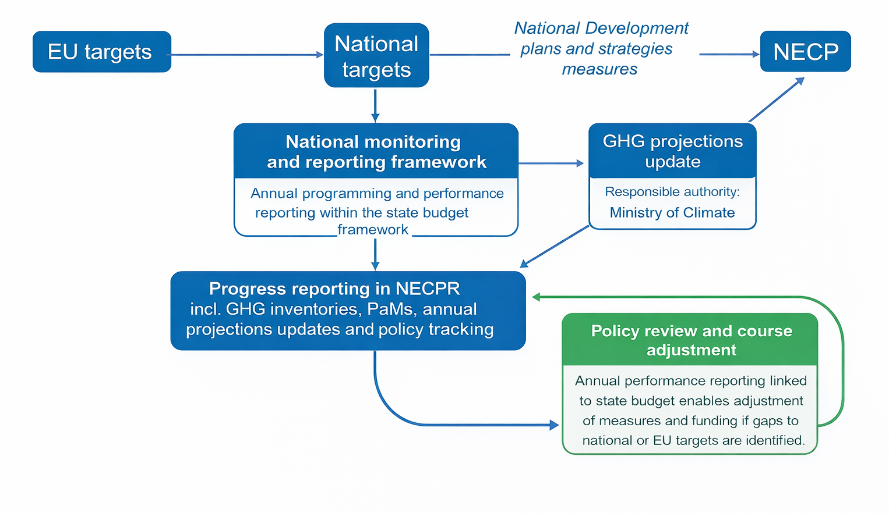
Integrating Commission recommendations into Estonia’s policy cycle
CHALLLENGES:
reporting vs policy cycles
investment planning uncertainty
administrative burden
data availability

Slide 5
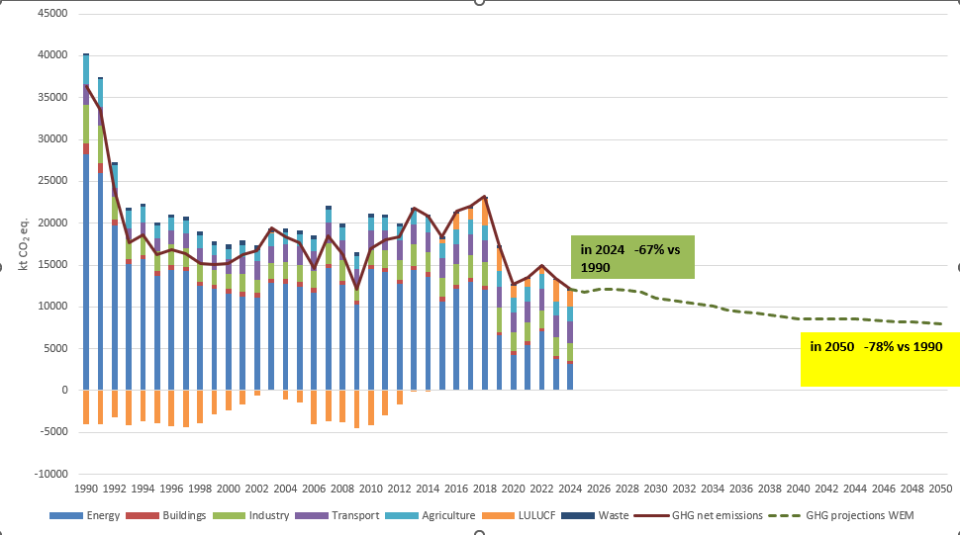
Estonian climate projections
Notes:
Siin ainult WEM, baseerub 15.03.2026 KHG inventuuril ja prognoosidel

Slide 6
Estonia's national climate and energy targets and identified target gaps
REDUCTION OF GHG EMISSIONS
Net emissions to zero (1990–2050)
SHARE OF RENEWABLE ENERGY
By 2030, at least 65% of total final energy consumption must come from renewable energy sources:
ENERGY CONSUMPTION
Final energy consumption must remain at 29.4 TWh per year until 2030.
Emissions in the Effort Sharing Regulation sectors in 2030: –24% compared to 2005
In the Land Use, Land-Use Change and Forestry (LULUCF) sector, net removals in 2030 must increase by 0.434 million tonnes of CO₂ equivalent compared to the 2016–2018 average
100% of total final electricity consumption
At least 63% of total final heat consumption from renewable energy
The share of renewable transport fuels in road and rail transport in accordance with the requirements set out in the Renewable Energy Directive.
The cumulative energy savings obligation for the period 2021–2030 amounts to 21.28 TWh.
Primary energy consumption must decrease by up to 48% by 2030 compared to the peak consumption in recent years (2016 = 69.8 TWh), meaning that primary energy consumption in 2030 must not exceed 36.5 TWh.
Notes:
Taking into account the five dimensions of the Energy Union, the main objectives of REKK 2030 are as follows: Estonia's long-term goal is to balance greenhouse gas emissions and removals by 2050 at the latest, i.e. to bring net greenhouse gas emissions to zero by 2050. In the sectors covered by the Effort Sharing Regulation (transport, small energy, agriculture, waste management, industrial processes), emissions in 2030 may total nearly 4.7 million tonnes of CO2 eq (2005=6.3 million tonnes of CO2 eq), i.e. by 2030, greenhouse gas emissions must be reduced by 24% compared to 2005. In the land use, land use change and forestry sector (so-called LULUCF), GHG removals must be 0.434 million tonnes of CO2 eq higher by 2030 compared to the base level (2016-2018 average). The share of renewable energy in total final energy consumption must be at least 65% in 2030, including electricity consumption must be ensured with renewable electricity at 100%, i.e. 9.4 TWh (2018 = 2.1 TWh, 2022 = 2.6 TWh) (depending on consumption, this may be achievable by 2035) Final energy consumption must remain at a level of up to 29.4 TWh/year until 2030, and the general fulfilment of the energy saving obligation in the period 2021-2030 in the volume of up to 21.28 TWh will help to keep final energy consumption at the same level. Indicative reduction of primary energy consumption by 2030 by up to 48% (compared to the peak of consumption in 2016 = 69.8 TWh), primarily due to a decrease in the use of oil shale and other fossil fuels, based on Article 4 of the draft new Energy Efficiency Directive, primary energy consumption in 2030 must be up to 36.5 TWh.

Slide 7
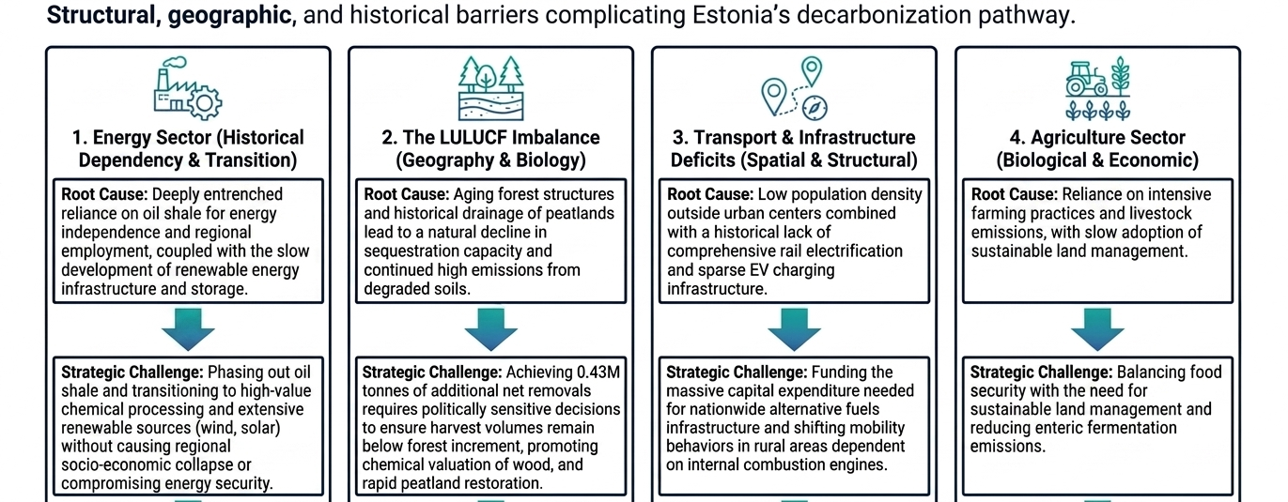
Understanding the Gaps: Root Causes and Strategic Challenges

Slide 8
Thank you!

